Slide 1


Quora Web Solution
Website Design and
Development
Company
Web Design & Web Development
Company in Bangalore, India
www.quorawebsolution.com
+91 9986 056 909
info@quorawebsolutions.com
24A, 1st Main Rd, Chandra Reddy
Layout, Koramangala 4th Block,
Koramangala, Bengaluru,
Karnataka 560034

Slide 2

A Comprehensive Guide to Website Design and Development for Small Businesses
www.quorawebsolution.com

Slide 3

In the digital age, a website is more than just a virtual storefront; it’s a vital tool for success.
www.quorawebsolution.com

Slide 4
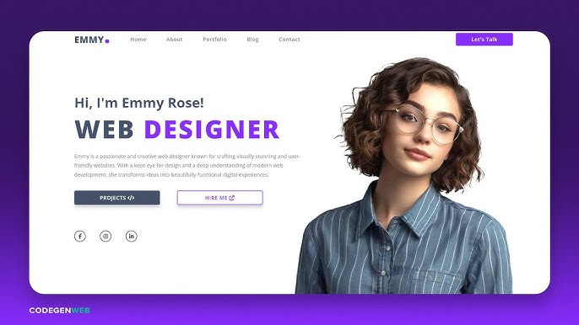
For small businesses, an effective website can mean the difference between growth and stagnation.
www.quorawebsolution.com

Slide 5
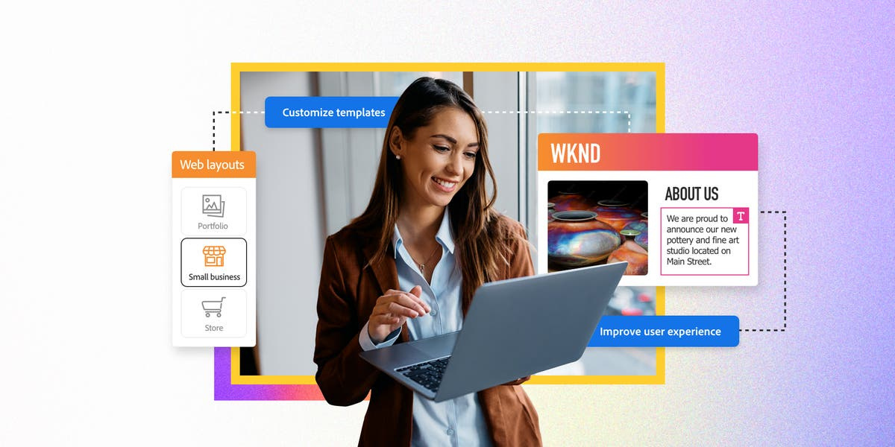
This guide walks you through the essentials of website design and development tailored specifically for small businesses.
www.quorawebsolution.com

Slide 6
Why Every Small Business Needs a Website
A professional website is a cornerstone of modern business strategy. Here are key reasons small businesses can’t afford to ignore their online presence:
Credibility and Trust: Customers often use websites to gauge a business’s legitimacy.
Increased Reach: A website helps you connect with customers beyond your immediate geographic area.
Customer Engagement: Features like blogs, newsletters, and live chats allow businesses to build lasting relationships with their audience.
Revenue Growth: E-commerce functionality or clear call-to-actions (CTAs) can significantly boost sales.
Essential Elements of Website Design for Small Businesses
Creating a functional and visually appealing website doesn’t have to break the bank.
www.quorawebsolution.com

Slide 7
Here are the core components to focus on:
1. User Experience (UX)
Simple Navigation: Menus should be clear and intuitive.
Responsive Design: Ensure the site adapts to all screen sizes, from desktops to smartphones.
Fast Load Times: Minimize load times to retain visitors.
2. Visual Appeal
Use high-quality images and consistent branding elements.
Choose a clean, professional design that reflects your business’s personality.
3. Content Quality
Engaging Headlines: Capture attention immediately.
www.quorawebsolution.com

Slide 8
Informative Pages: Include clear descriptions of your products, services, and value propositions.
SEO Practices: Use keywords effectively to improve visibility on search engines.
4. Core Pages
Homepage: Introduce your business and key offerings.
About Us: Share your mission, vision, and story to connect emotionally with visitors.
Products/Services: Detail your offerings with visuals and benefits.
Contact: Provide contact forms, phone numbers, and physical addresses.
FAQ or Testimonials: Address common queries or showcase satisfied customer feedback.
The Website Development Journey
Building a website involves multiple stages. Here’s a step-by-step overview:
www.quorawebsolution.com

Slide 9
Step 1: Planning
Identify your audience and define clear goals.
Map out the site structure to ensure a seamless user journey.
Step 2: Designing
Create wireframes to outline page layouts.
Choose design elements such as fonts, colors, and images that align with your brand.
Step 3: Development
Select the right platform: WordPress, Shopify, or Wix are great options for small businesses.
Incorporate essential features like mobile optimization, contact forms, and social media links.
Step 4: Testing and Launch
Test your site for responsiveness, load times, and browser compatibility.
www.quorawebsolution.com

Slide 10
Launch and monitor user feedback to make adjustments as needed.
Hiring a Website Design and Development Team
While DIY platforms are appealing, hiring professionals can elevate your website significantly. Benefits include:
Expertise: Skilled designers and developers ensure a polished, functional site.
Time Efficiency: Focus on your business while experts handle the technical aspects.
Customization: Get a site tailored to your unique business needs.
Ongoing Support: Professionals offer maintenance and updates post-launch.
Tips for Choosing the Right Partner
Portfolio Review: Assess their past work to ensure it aligns with your vision.
www.quorawebsolution.com

Slide 11
Transparent Pricing: Confirm their rates fit within your budget.
Customer Support: Ensure they provide continued support after the site goes live.
Future-Proofing Your Website
Once your site is live, regular updates and improvements are essential to remain competitive. This includes:
Updating content to reflect new products or services.
Adding features like chatbots or appointment booking tools.
Monitoring performance metrics and optimizing accordingly.
www.quorawebsolution.com

Slide 12
Conclusion
Investing in website design and development is one of the smartest decisions a small business can make. A well-crafted website not only enhances your brand’s reputation but also acts as a powerful tool to attract and retain customers. With a focus on usability, quality content, and professional support, your website can become the cornerstone of your business’s success.
Why Partnering with a Website Design and Development Company is Essential for Startups
www.quorawebsolution.com

Slide 13
In the fast-paced digital world, having an online presence is no longer optional for businesses, especially startups. As entrepreneurs seek to carve out their niche in competitive markets, one of the most crucial steps they must take is establishing a strong, user-friendly website. While many startups might consider DIY website builders or freelance developers, partnering with a professional website design and development company offers numerous advantages. Here’s why it’s essential for startups to collaborate with experts in this field.
1. Professional Expertise for a Seamless User Experience
A website is more than just a digital brochure; it’s an essential tool for customer engagement, marketing, and conversion. Professional website design and development companies bring specialized skills to the table.
www.quorawebsolution.com

Slide 14
They understand how to design websites that are not only visually appealing but also user-friendly and optimized for performance. A seamless user experience (UX) is key to keeping visitors on your site and converting them into customers. Experts know the nuances of layout, navigation, and accessibility that make all the difference in user retention.
2. Tailored Solutions to Match Your Brand
Startups have unique needs, and one-size-fits-all solutions often fail to deliver the desired results. By working with a website design and development company, your site can be customized to reflect your brand identity. A professional team takes the time to understand your business model, goals, and target audience before developing a design that aligns with your vision. Whether you need e-commerce capabilities, a portfolio site, or a blog, professionals can build a website that meets all your specific needs.
www.quorawebsolution.com

Slide 15
3. Mobile-First Approach
With mobile usage surpassing desktop browsing globally, it’s crucial that your website is mobile-responsive. A professional website development company ensures your website is optimized for mobile devices, providing a smooth experience across all platforms. This not only boosts your site's usability but also improves its search engine ranking, as Google prioritizes mobile-friendly websites.
4. Scalability for Growth
Startups are dynamic and often experience rapid growth. As your business expands, so will your website needs. A professional website design and development company builds websites that can scale with your business.
www.quorawebsolution.com

Slide 16
Whether it's adding new pages, features, or even integrating with other software, professionals ensure your website infrastructure is capable of handling increased traffic and additional functionality without compromising performance.
5. Search Engine Optimization (SEO)
Building a beautiful website is just the first step; getting noticed is the real challenge. SEO is the process of optimizing your website to appear higher in search engine results, and it requires specialized knowledge. A website design and development company knows how to implement effective SEO strategies, such as keyword optimization, meta tags, alt text, and mobile optimization, to improve your site’s visibility. Ranking higher in search results drives organic traffic to your site and increases your chances of attracting potential customers.
www.quorawebsolution.com

Slide 17
6. Time and Cost Efficiency
For a startup, time is money. Attempting to build a website without professional help often results in costly mistakes that can take up valuable time and resources. By outsourcing to a design and development company, you free up time to focus on other crucial aspects of your business, such as product development, sales, and marketing. Additionally, a professional team can help you avoid the long-term costs associated with poor design, slow performance, or inefficient functionality.
7. Ongoing Support and Maintenance
A website is not a one-time project. It requires regular updates, security patches, and performance checks. Many professional website design and development companies offer ongoing maintenance and support services. This ensures your website is always up to date with the latest features and security protocols.
www.quorawebsolution.com

Slide 18
For a startup, having reliable support can make a huge difference, especially when facing technical issues that may affect your online reputation or sales.
8. Enhanced Security Features
Startups are often more vulnerable to cyber threats because they lack the resources to dedicate to cybersecurity. Professional website development companies are well-versed in the latest security protocols, ensuring your website is protected against common threats like hacking, malware, and data breaches. Protecting customer information and ensuring a secure shopping experience is vital for gaining trust and credibility in the online marketplace.
9. Analytics and Tracking for Growth Insights
A well-designed website goes beyond aesthetics—it can also serve as a powerful tool for business analysis.
www.quorawebsolution.com

Slide 19
Professional web developers integrate tracking systems like Google Analytics into your site to help you monitor visitor behavior, conversion rates, and other critical data. By analyzing this data, you can make informed decisions about your marketing strategies and business operations, which are especially vital for the growth of a startup.
10. Competitive Advantage
In today’s competitive marketplace, having a professional website gives startups a competitive edge. A well-designed, high-performing website signals professionalism, trustworthiness, and credibility, which can set you apart from your competitors. When potential customers visit your website, they’re likely to form their first impression of your business, and a polished, functional site is essential in making a positive impact.
www.quorawebsolution.com

Slide 20
Conclusion
For startups looking to make a mark in their industry, partnering with a professional website design and development company is not just a smart choice; it’s a necessary step for success. From creating a mobile-friendly, SEO-optimized site to ensuring scalability and security, the advantages are clear. As your startup grows, so will the demands of your online presence, and working with experts ensures you have the support you need to stay ahead in the digital landscape. In today’s digital-first world, your website is often the first interaction potential customers have with your brand—make it count.
www.quorawebsolution.com

Slide 21
Quora Web Solution: Quora Web Solution is a trusted website development company based in Bangalore, India, offering a wide array of services to not only domestic but global clientele. Be it Website Design and Development, SEO services, Digital Marketing, Branding, App Development, Ecommerce Solution, and Logo Creation . Quora Web Solution has the best website developers offering top quality services and that is the reason why we are well known as one of the best Website Development Companies in Bangalore, India.
Visit Us - www.quorawebsolution.com
Call Us - +91 9986 056 909
Mail Us - info@quorawebsolutions.com
www.quorawebsolution.com

Slide 22

WORDPRESS DEVELOPMENT
ECOMMERCE DEVELOPMENT
PHP DEVELOPMENT
CMS DEVELOPMENT
DRUPAL DEVELOPMENT
WEBSITE SERVICES
WEBPORTAL DEVELOPMENT
MAGENTO DEVELOPMENT
WEBSITE DEVELOPMENT
JOOMLA DEVELOPMENT
SMALL BUSINESS DEVELOPMENT
CHEAP WEBSITE DEVELOPMENT
STATIC WEBSITE DEVELOPMENT
DYNAMIC WEBSITE DEVELOPMENT
WEBSITE DESIGN COMPANY
TOUR AND TRAVEL WEBSITE DEVELOPMENT
Services

